Slide 1
Camera Calibration
Reading:
[FP] Chapter 1 “Geometric Camera Calibration”
[HZ] Chapter 7 “Computation of Camera Matrix P”
Some slides in this lecture are courtesy to Prof. Silvio Savarese, J. Ponce, F- Li

Slide 2
Agenda
Camera calibration problem
Example

Slide 3
Agenda
Camera calibration problem
Example

Slide 4
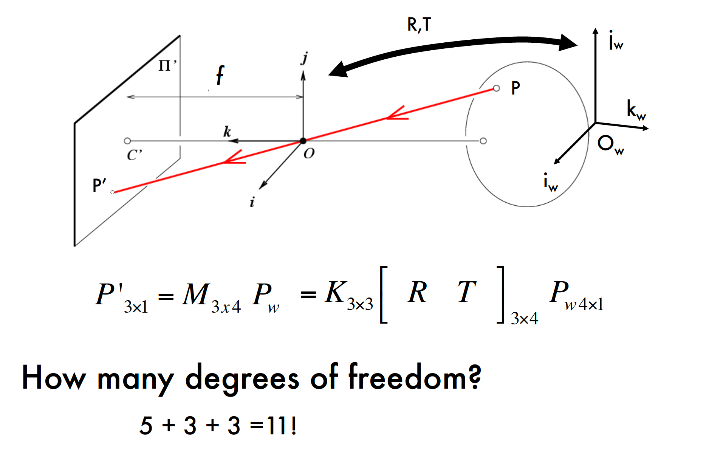
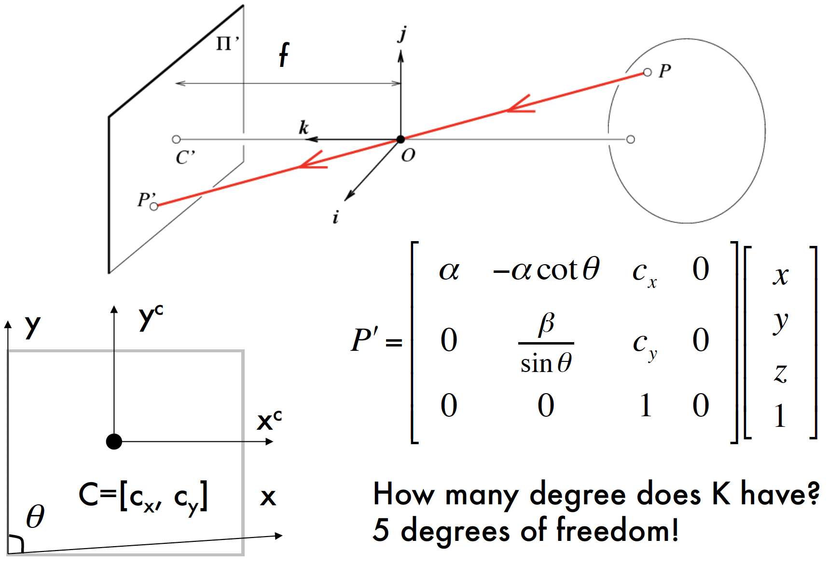
Recap: The projective transformation

Slide 5
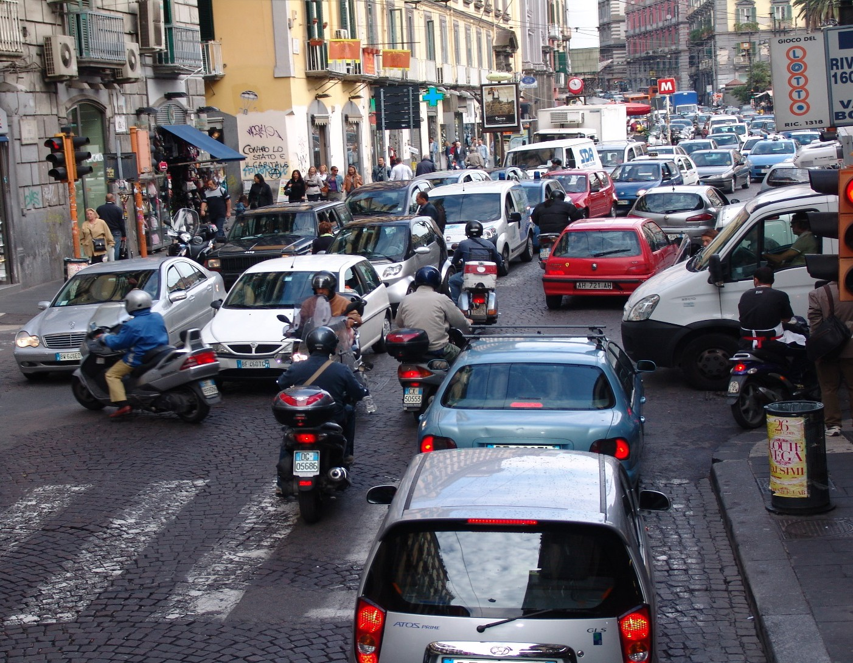
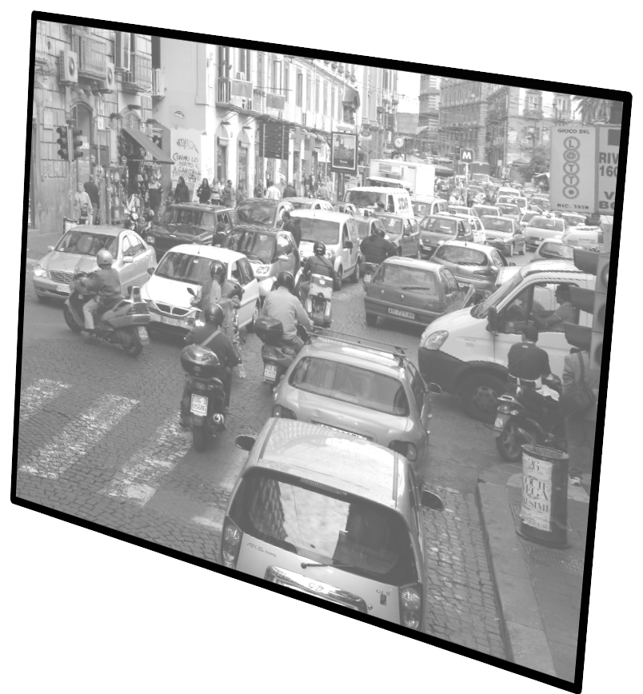
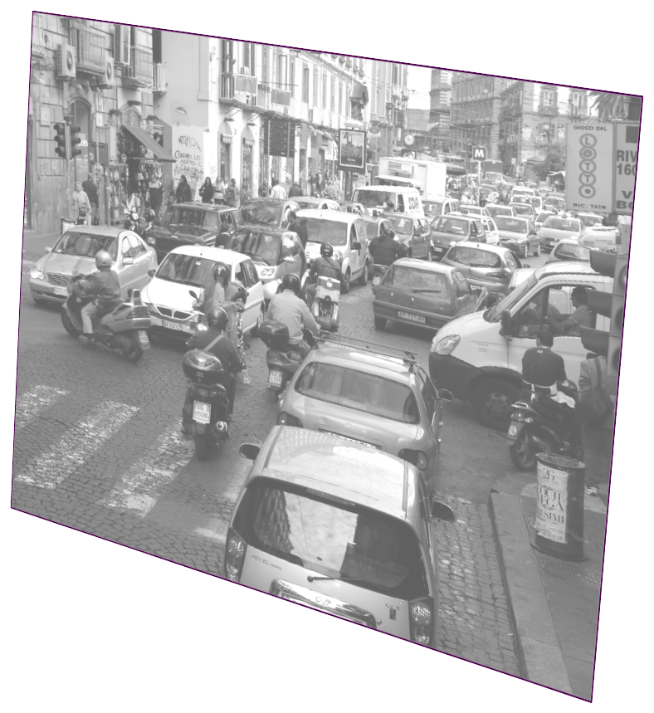
Why is this important?
Estimate camera parameters such pose or focal length from images!
?

Slide 6
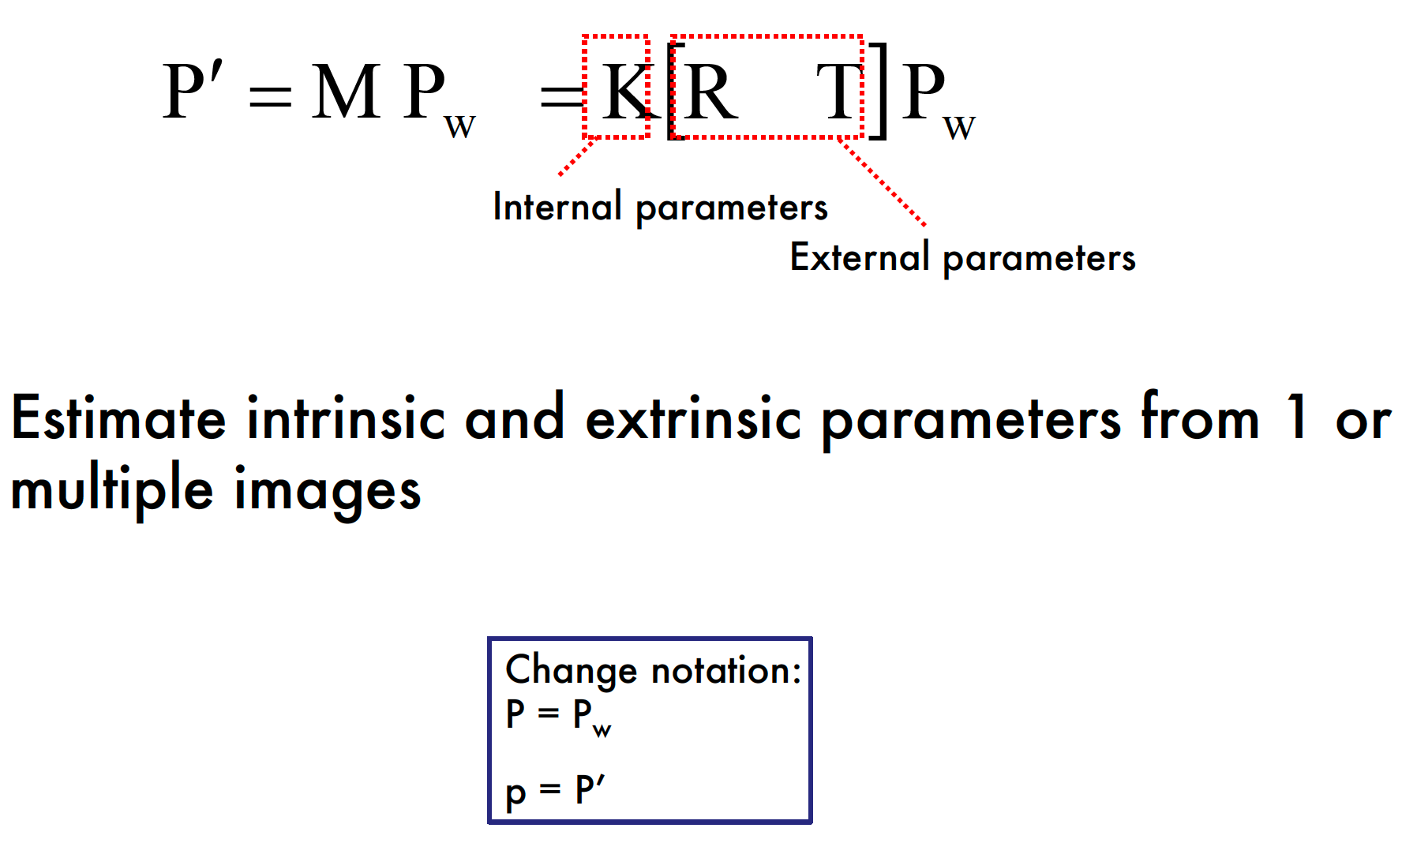
Goal of calibration

Slide 7
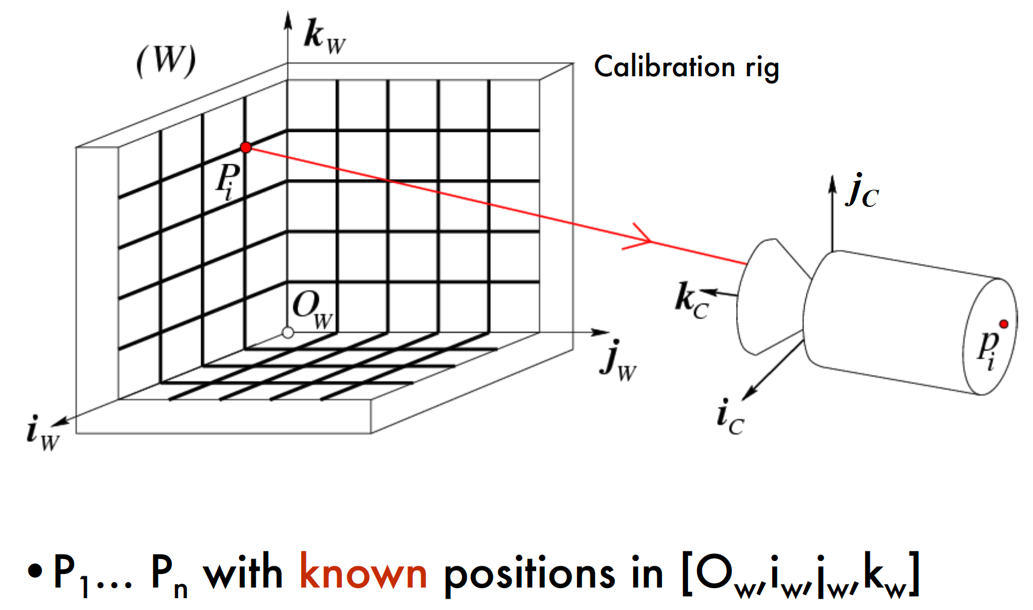
Calibration Problem

Slide 8
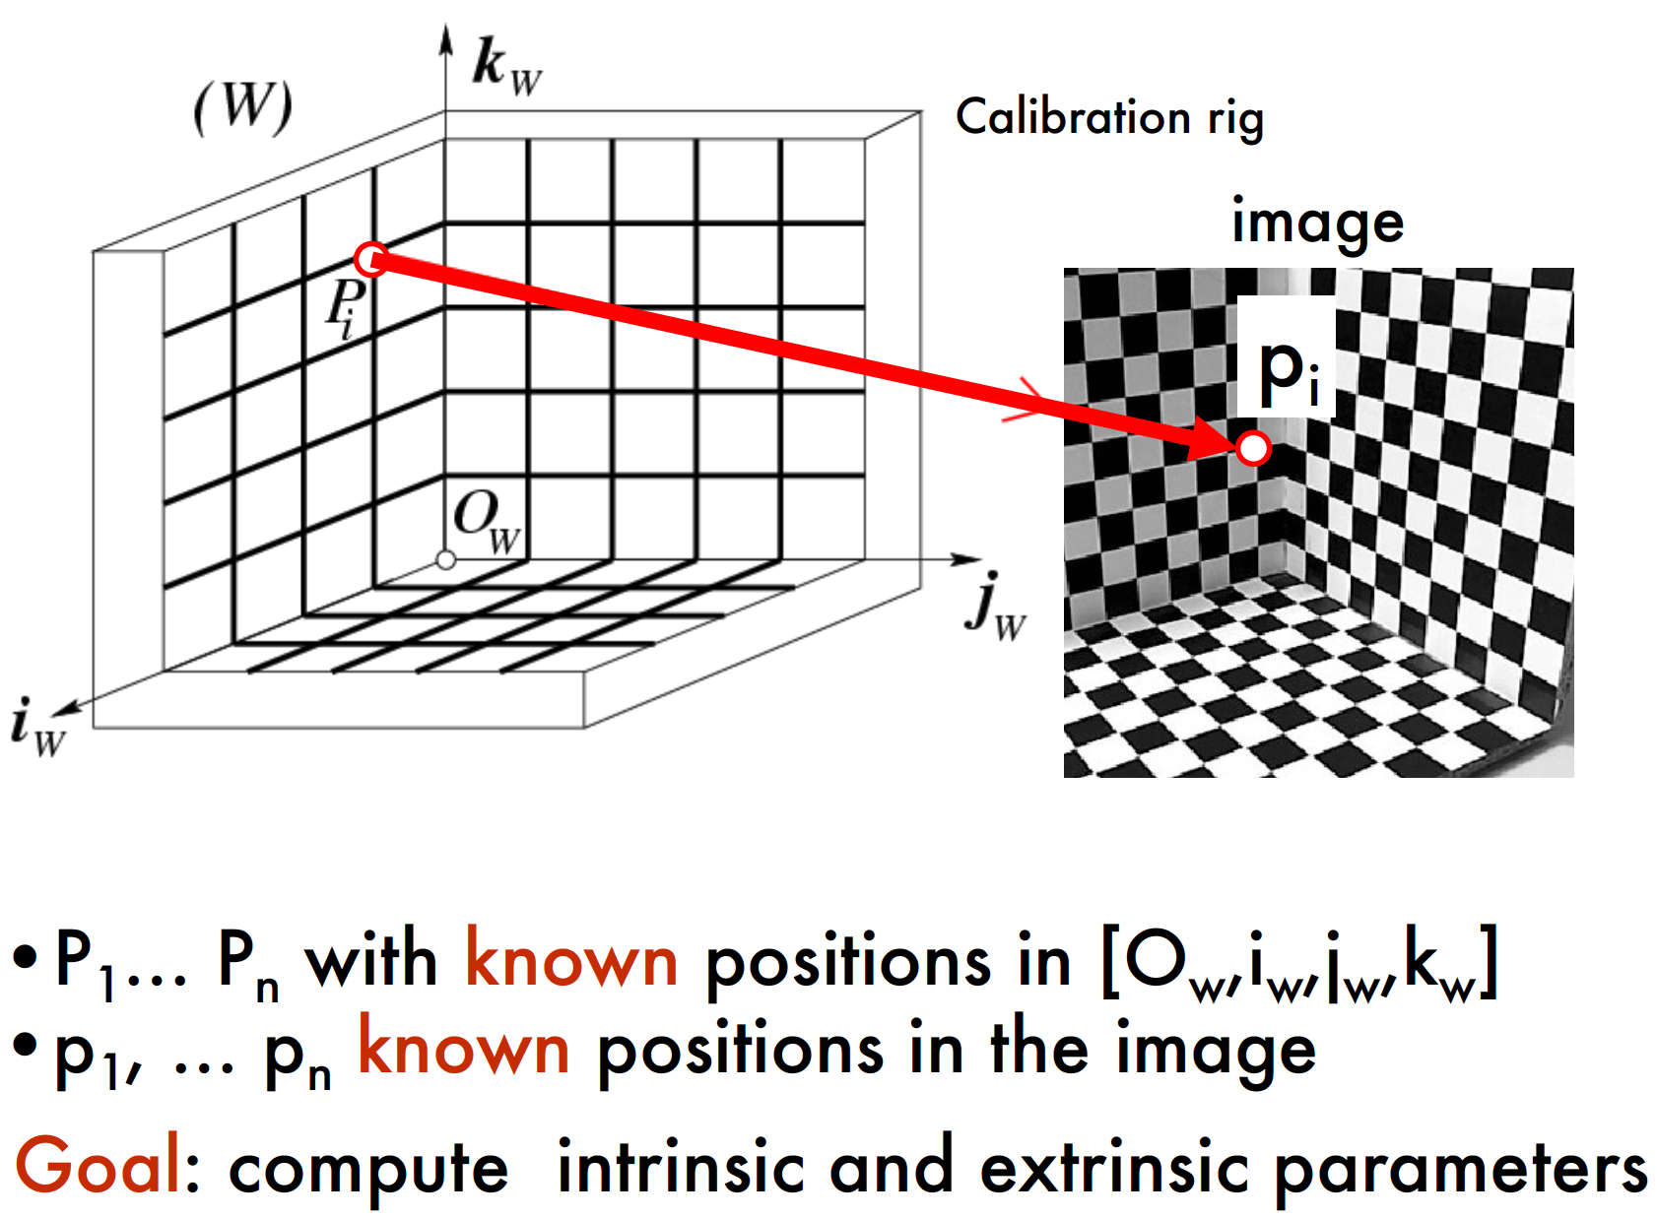
Calibration Problem

Slide 9
Calibration Problem

Slide 10
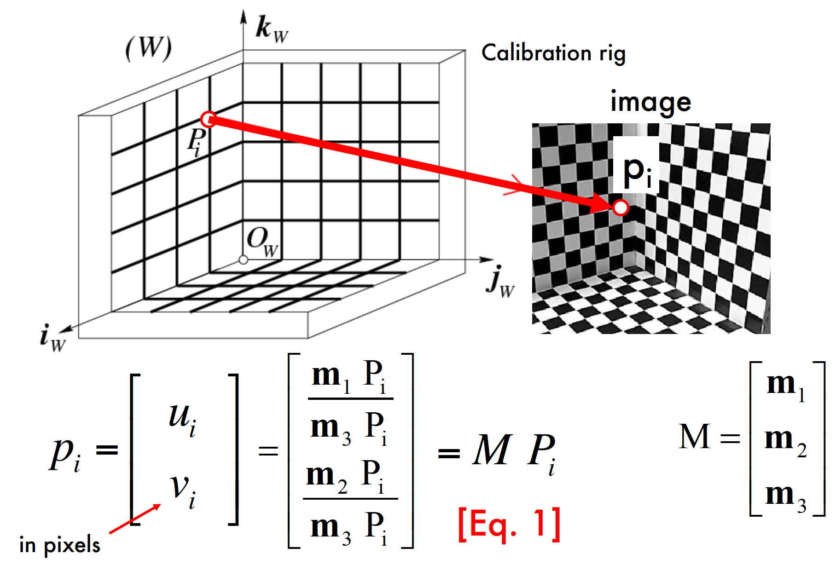
Calibration Problem

Slide 11
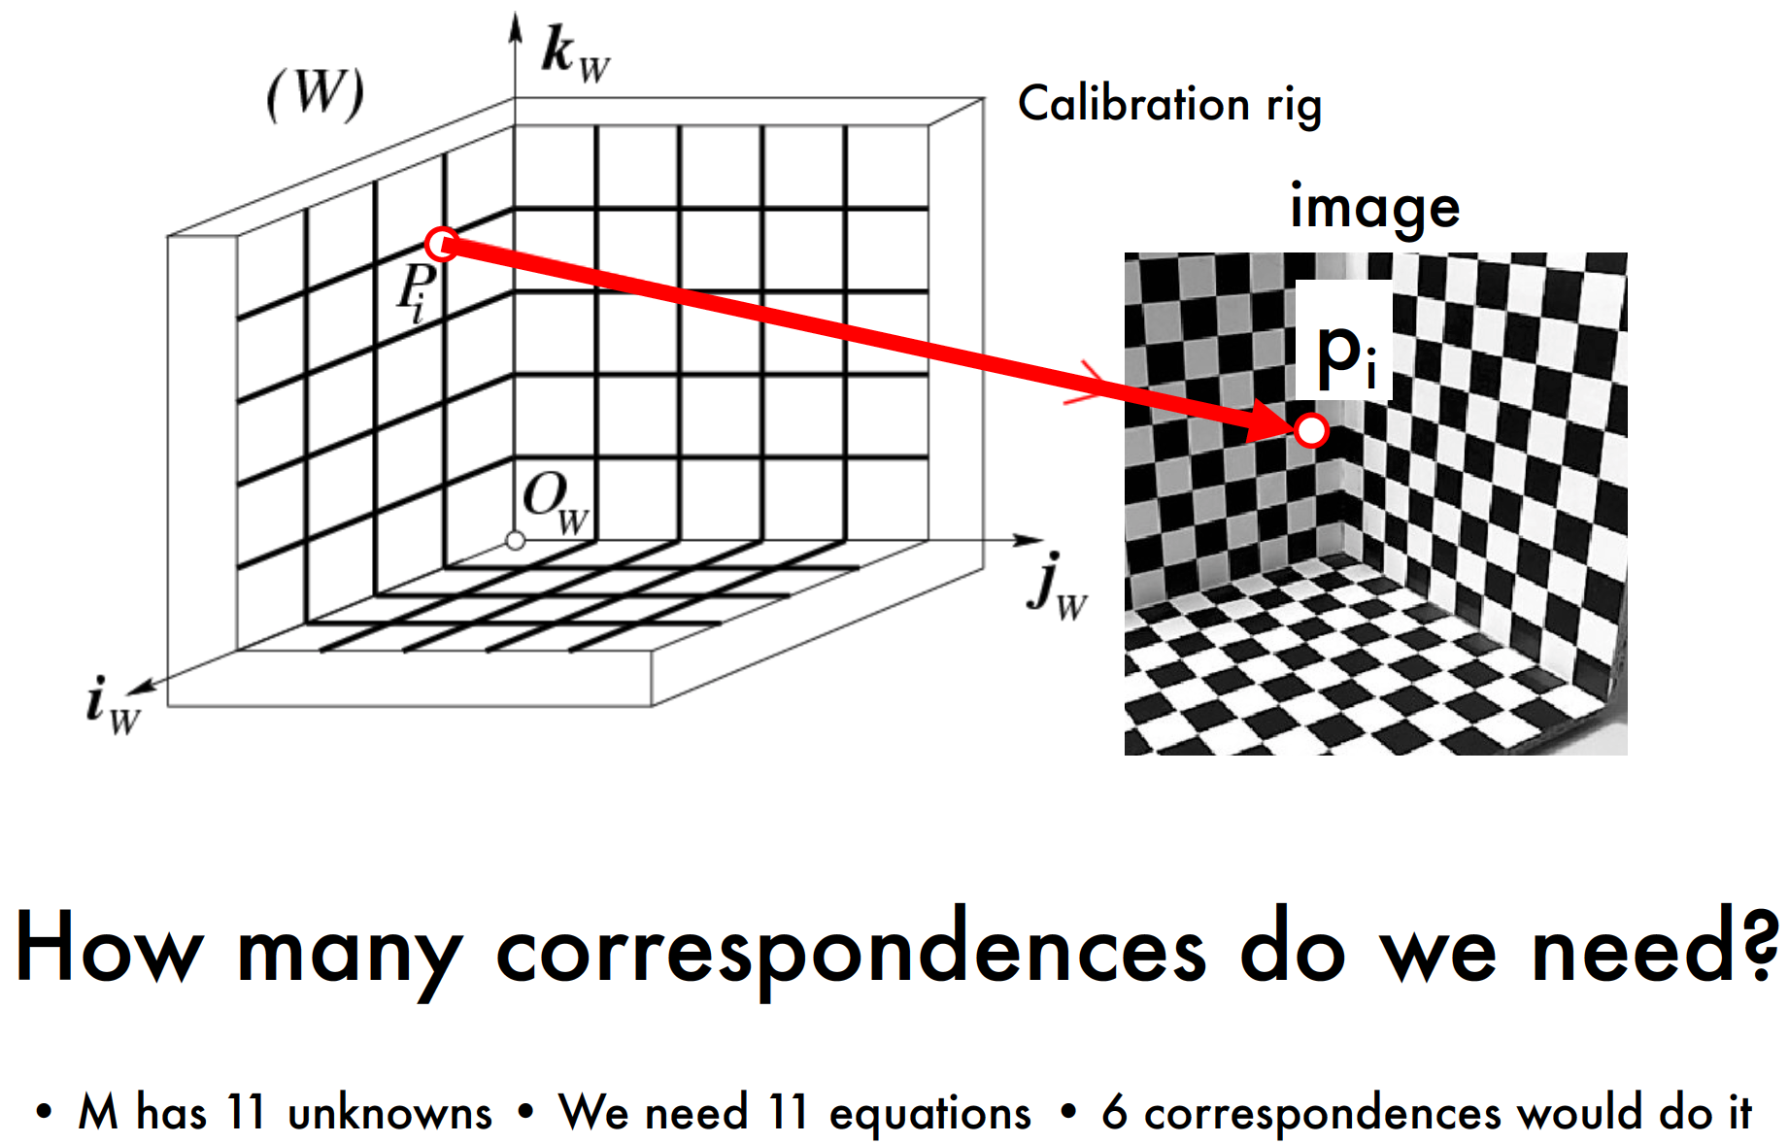
Calibration Problem

Slide 12
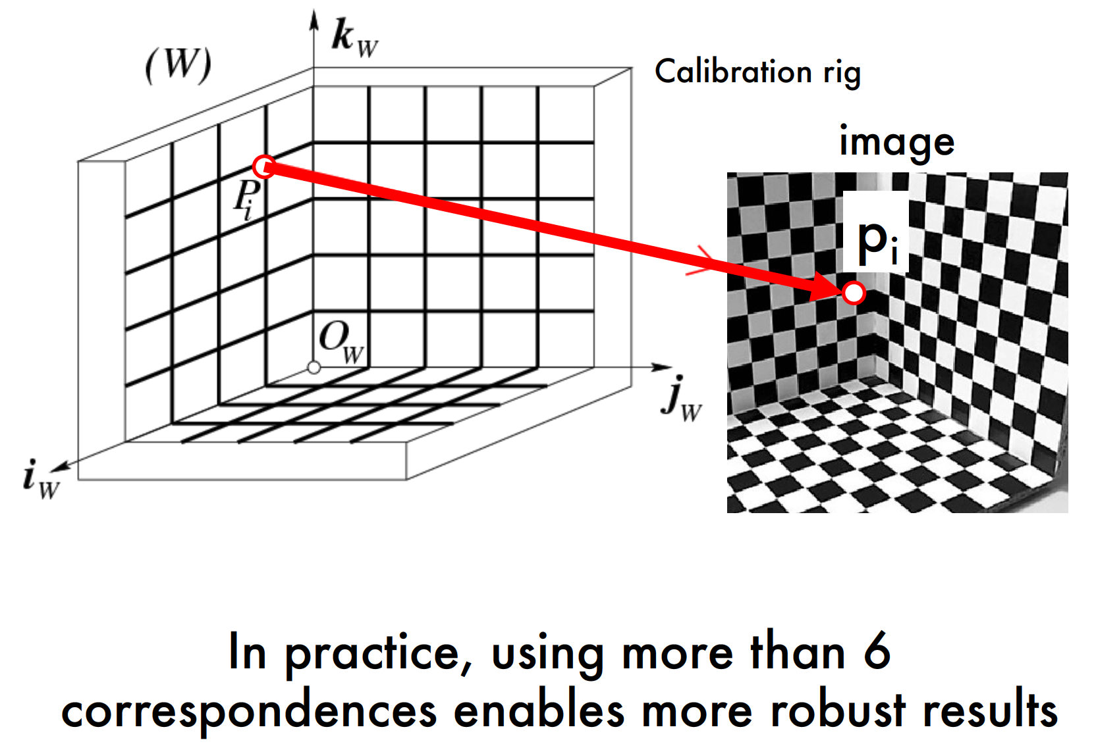
Calibration Problem

Slide 13
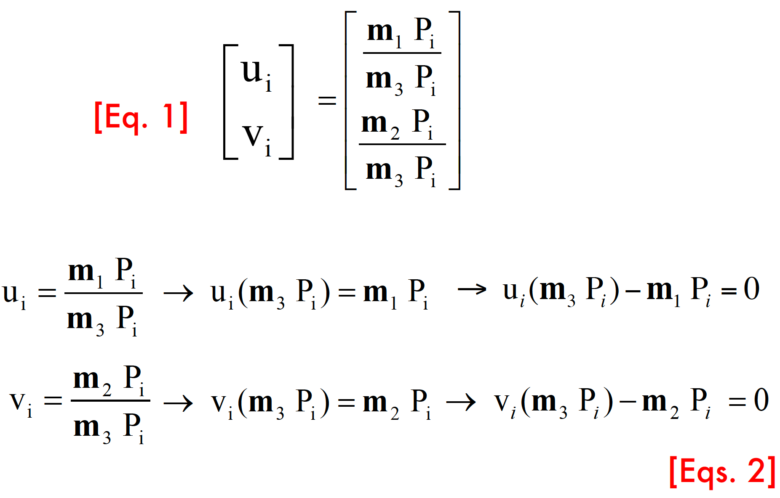

Slide 14
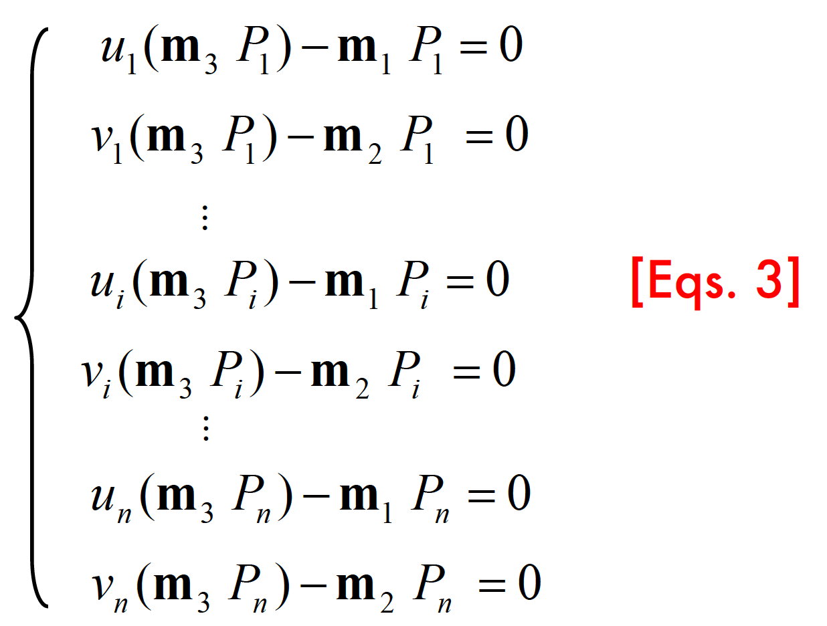

Slide 15
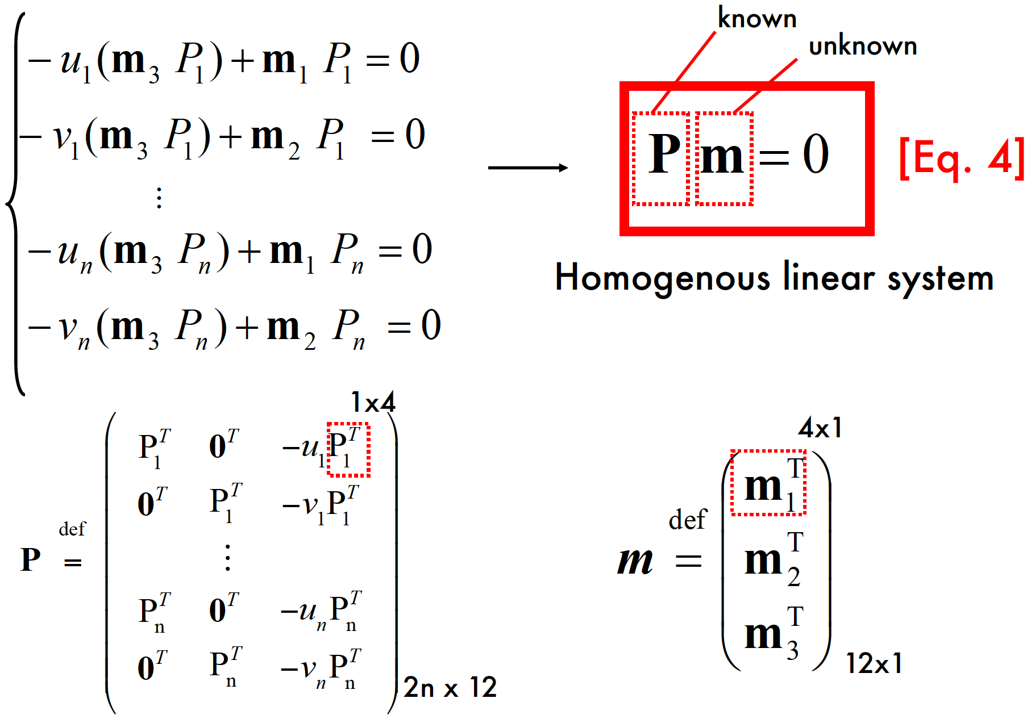

Slide 16
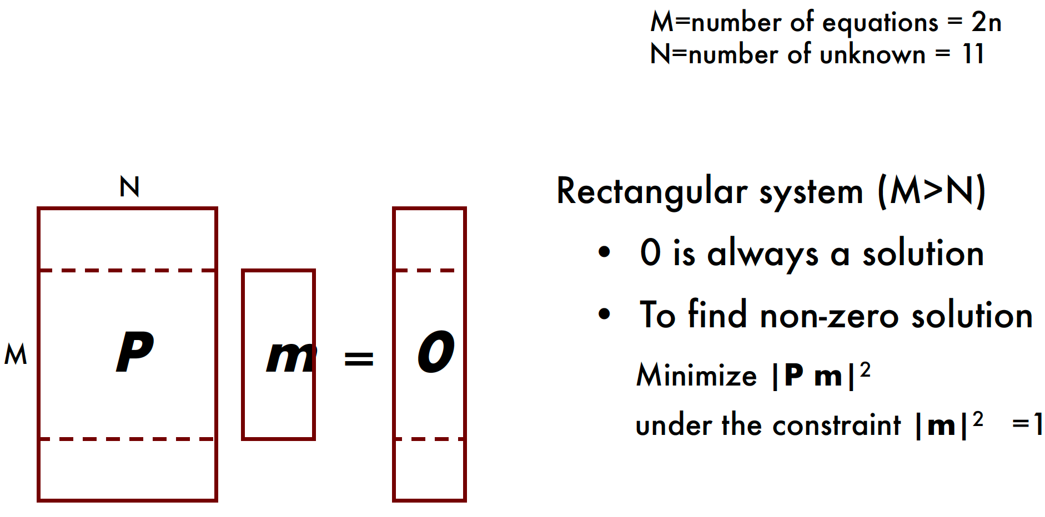
Homogeneous M x N Linear Systems

Slide 17
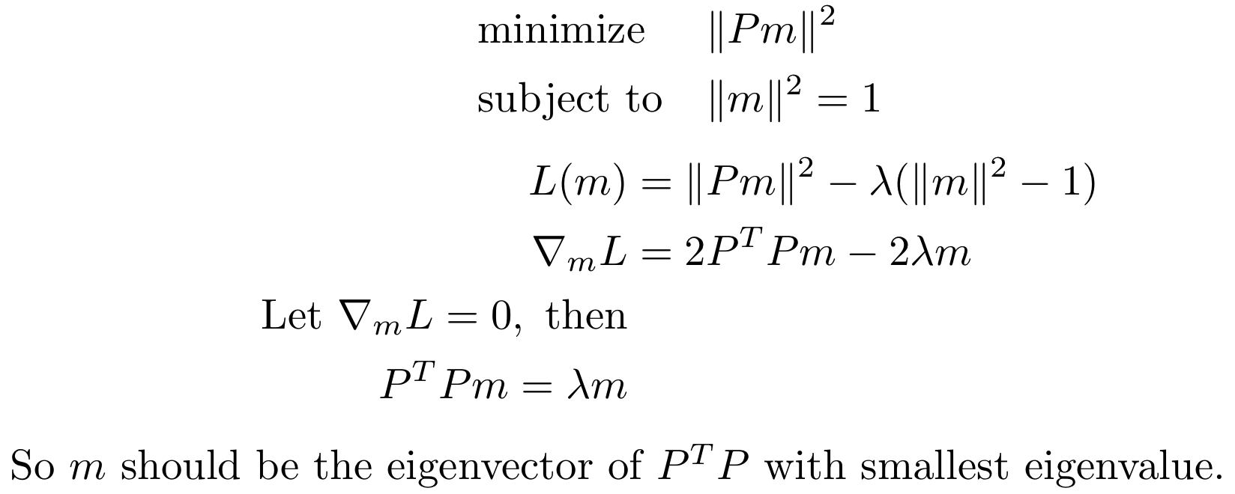

Slide 18

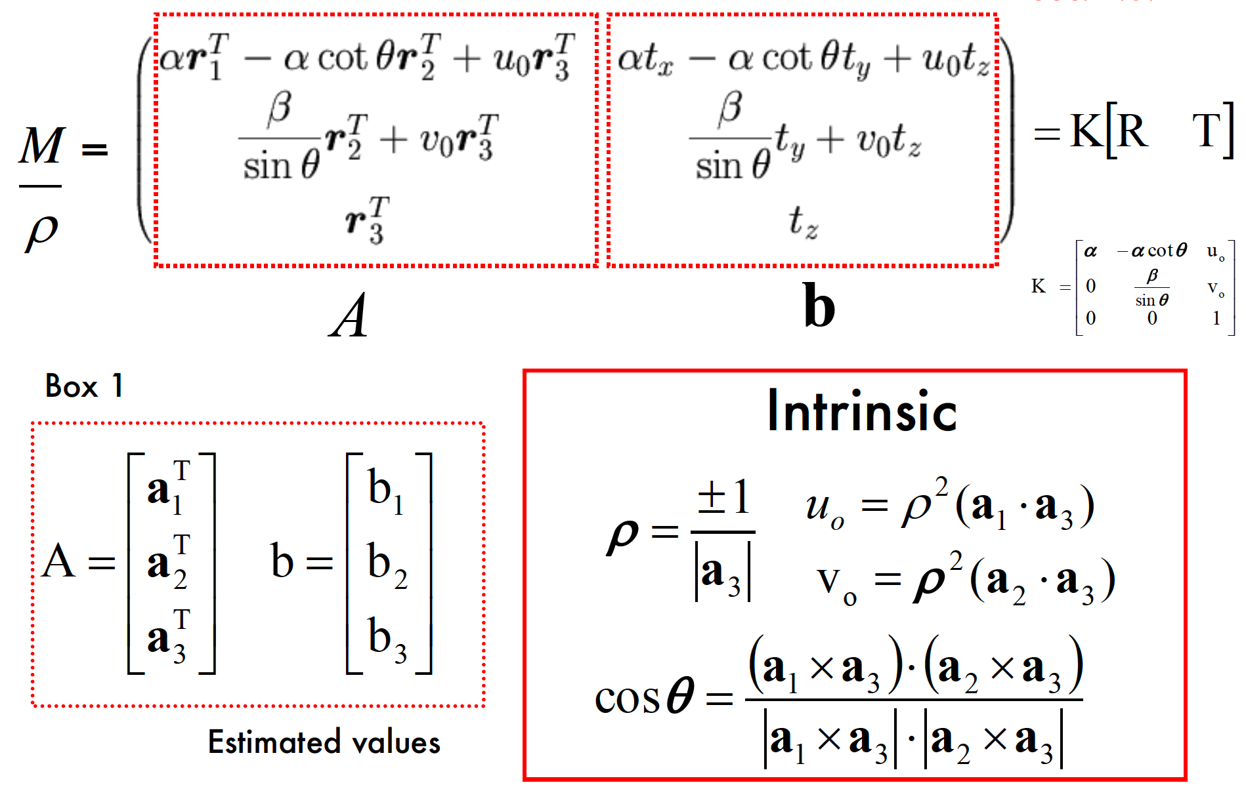
Extracting camera parameters

Slide 19
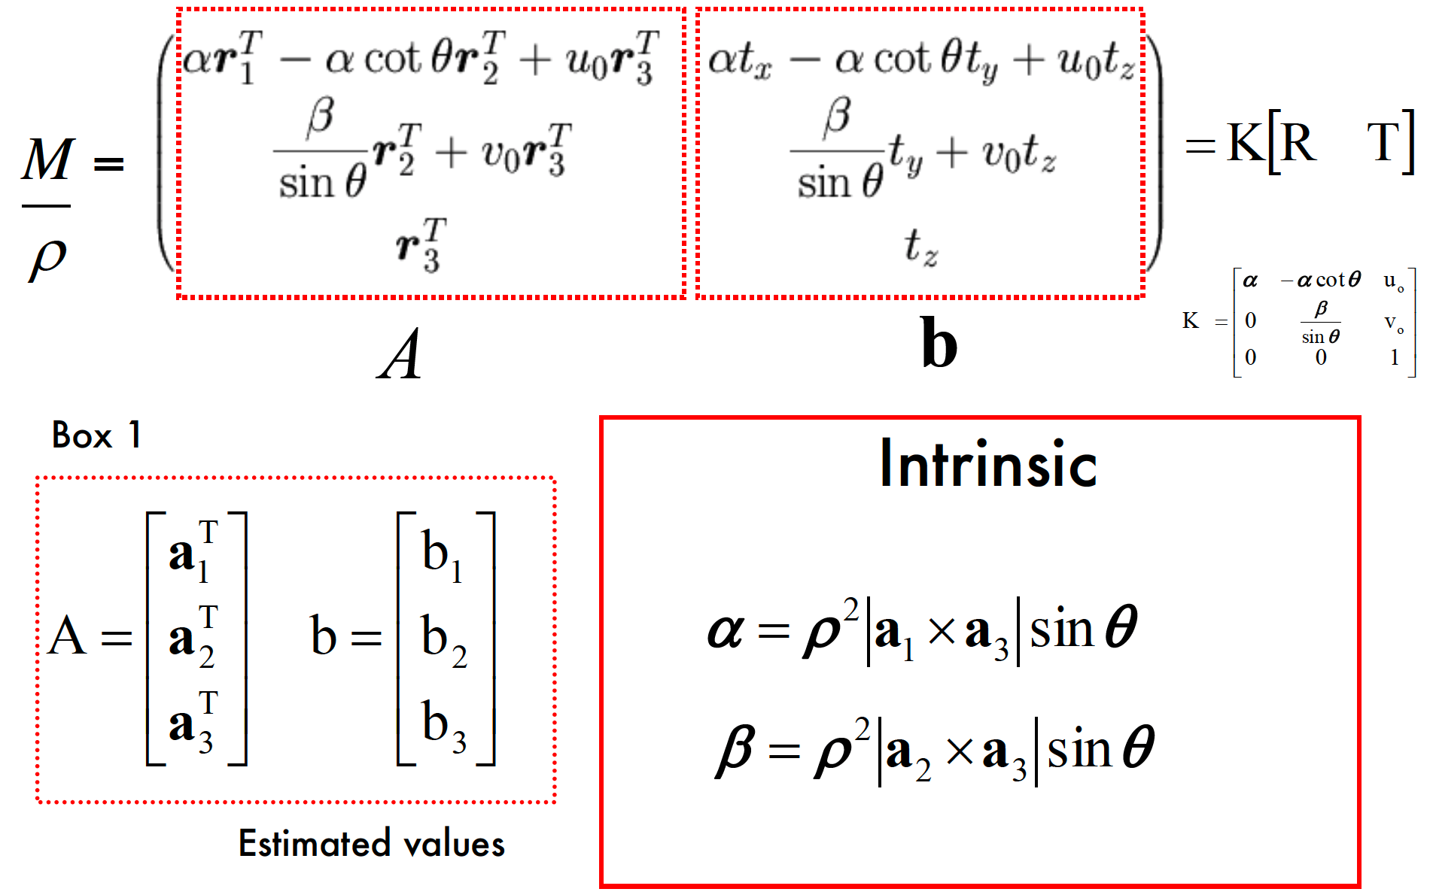
Extracting camera parameters

Slide 20
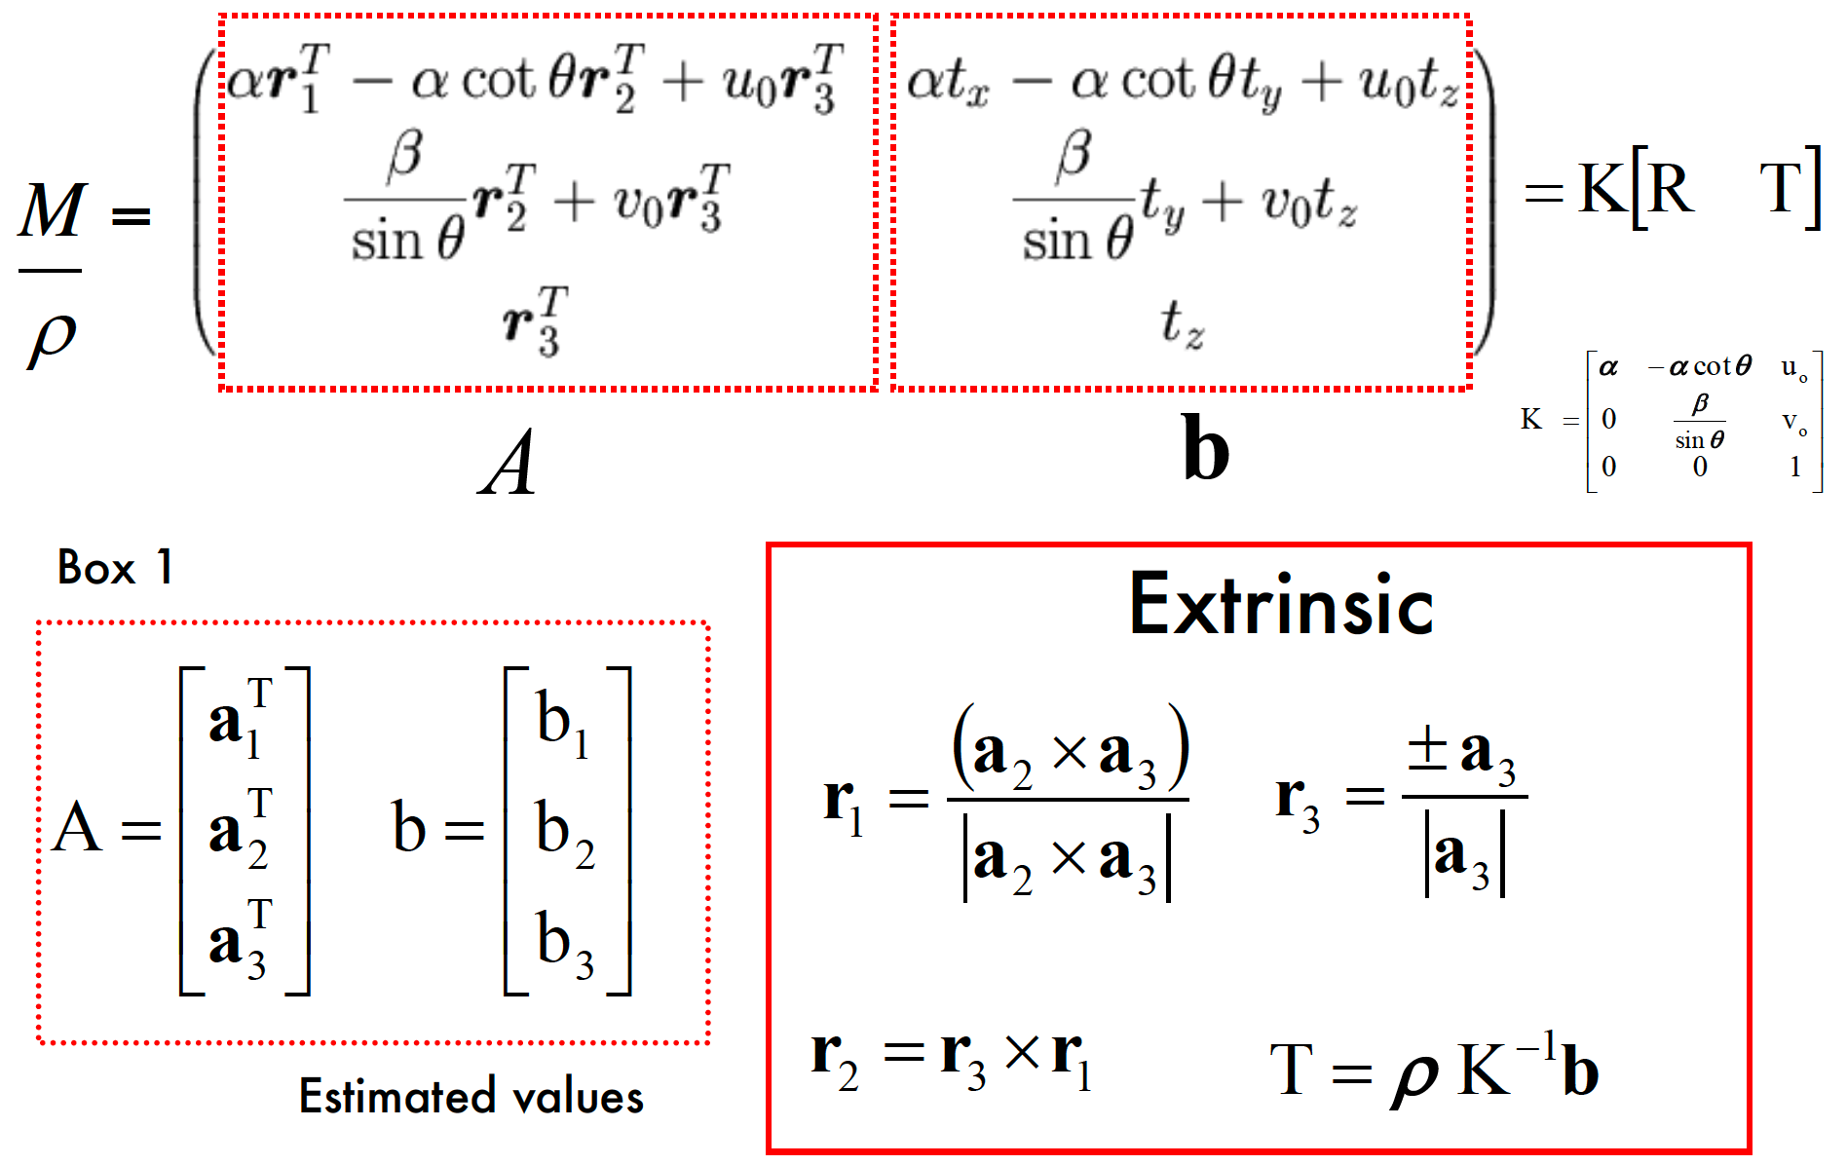
Extracting camera parameters

Slide 21
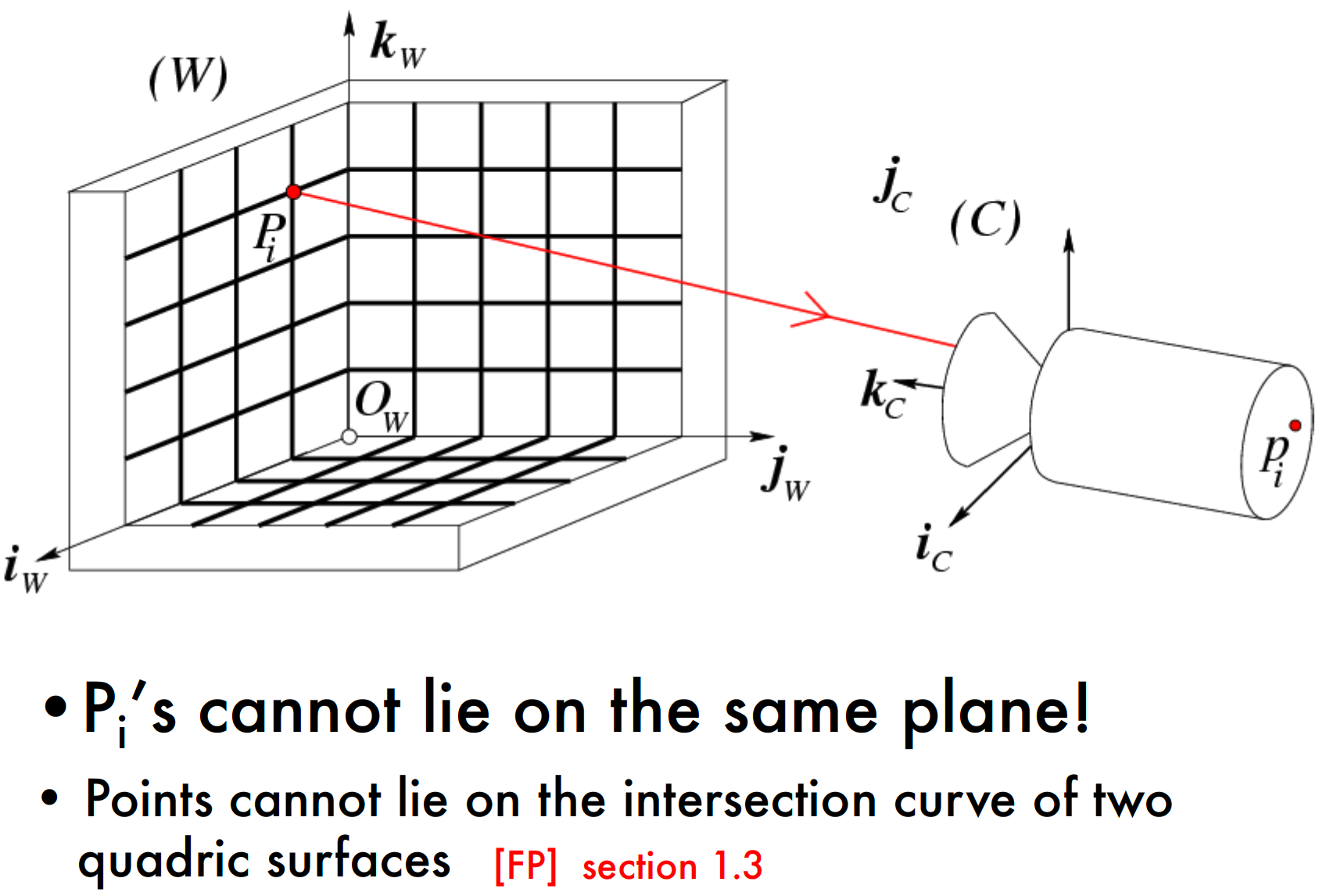
Degenerate cases

Slide 22
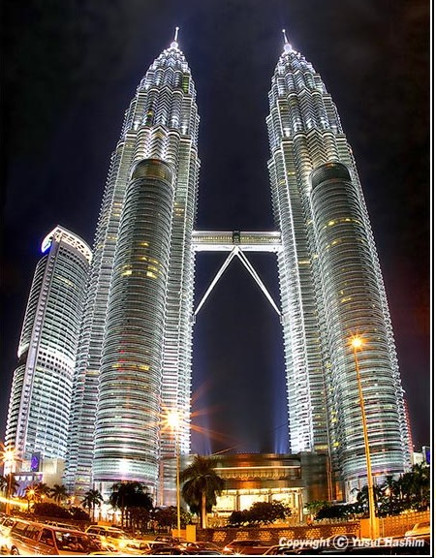
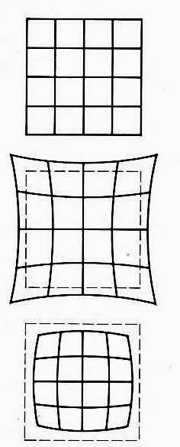
Radial Distortion
Image magnification (in)decreases with distance from the optical axis
Caused by imperfect lenses
Deviations are most noticeable for rays that pass through the edge of the lens
No distortion
Pin cushion
Barrel

Slide 23
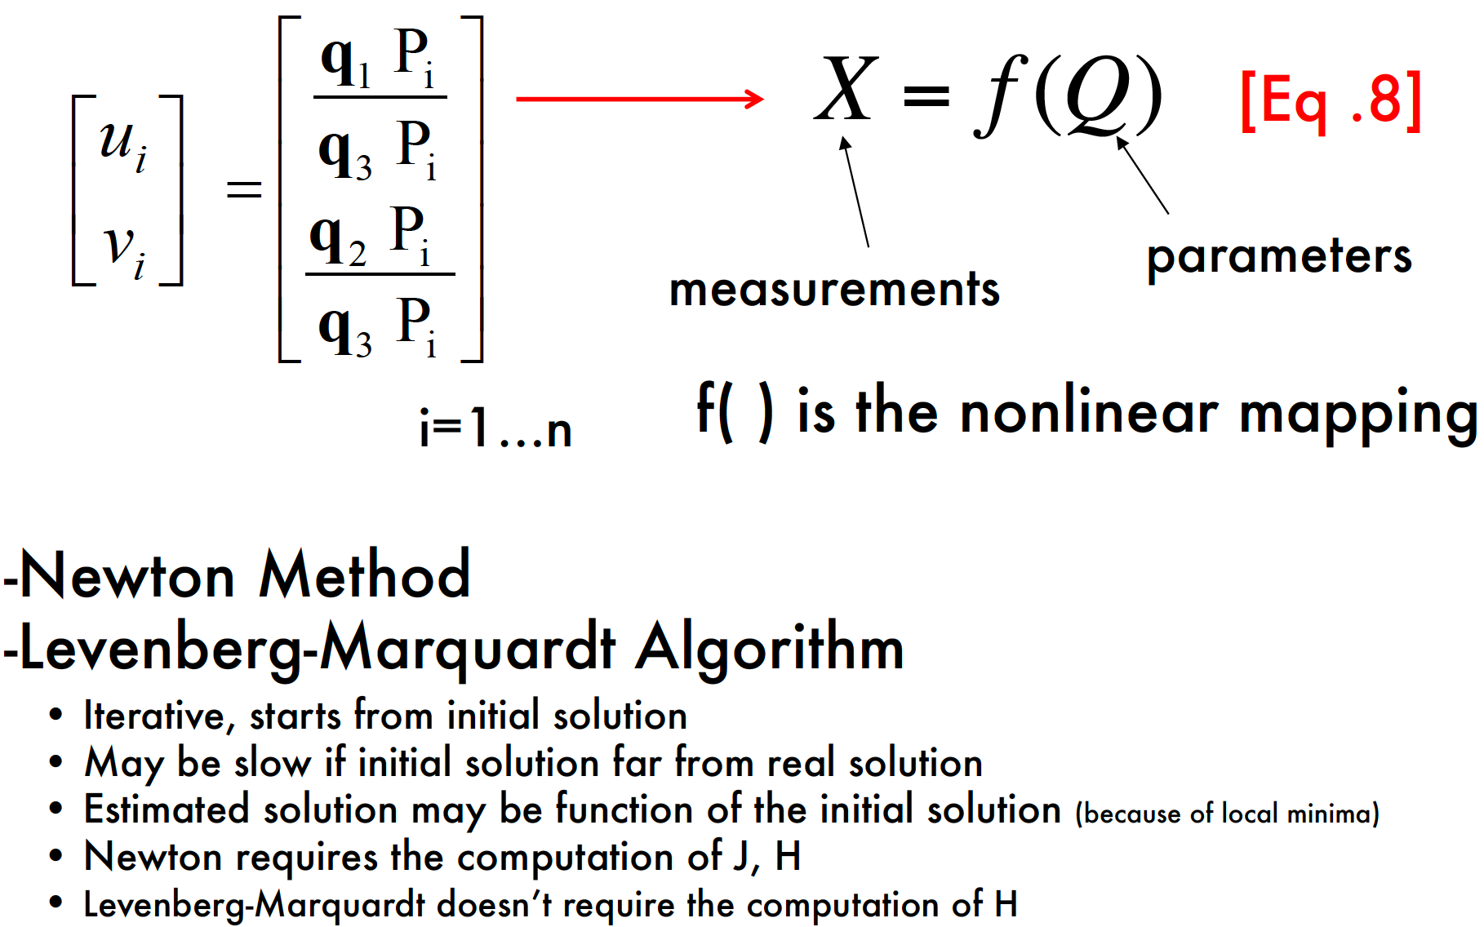
General Calibration Problem

Slide 24
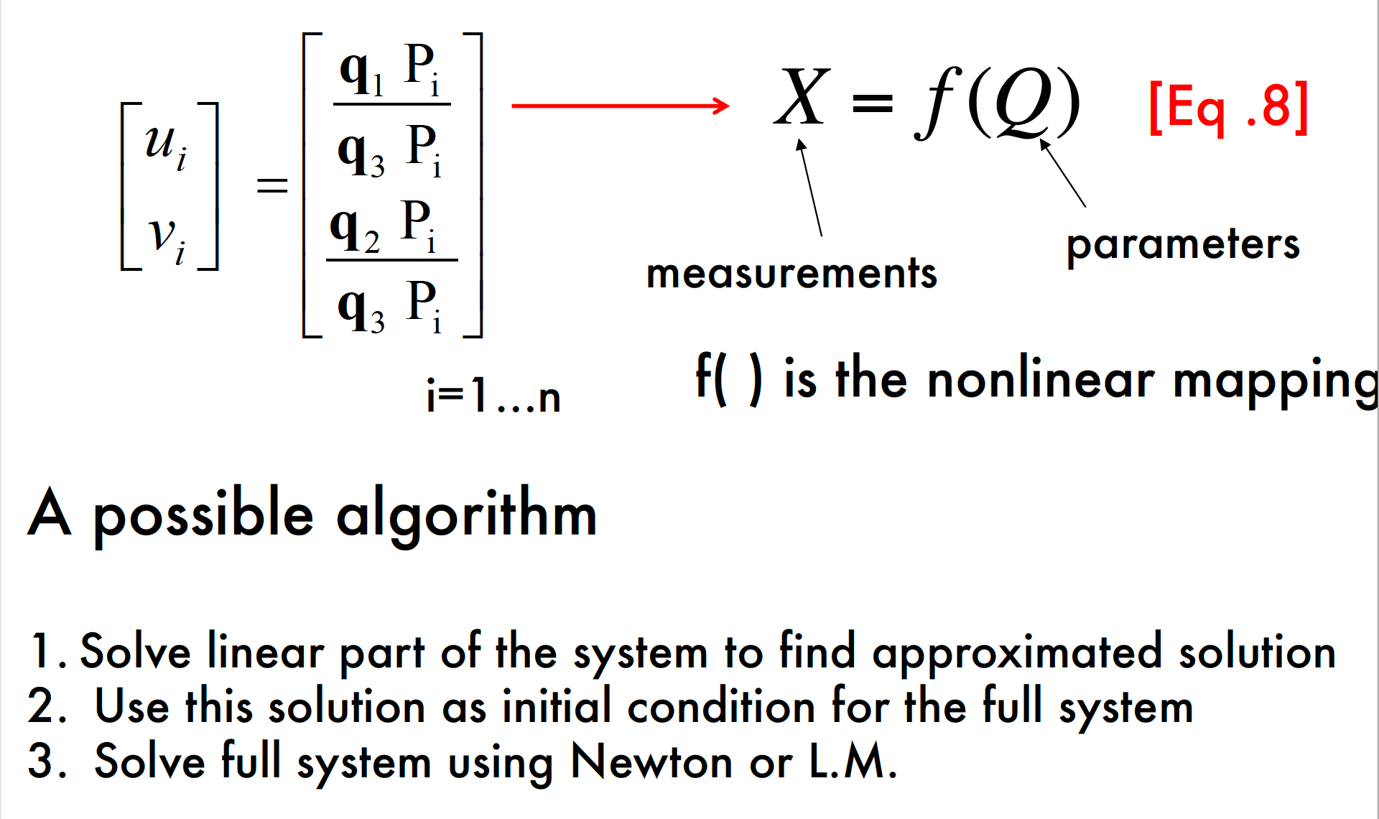
General Calibration Problem

Slide 25
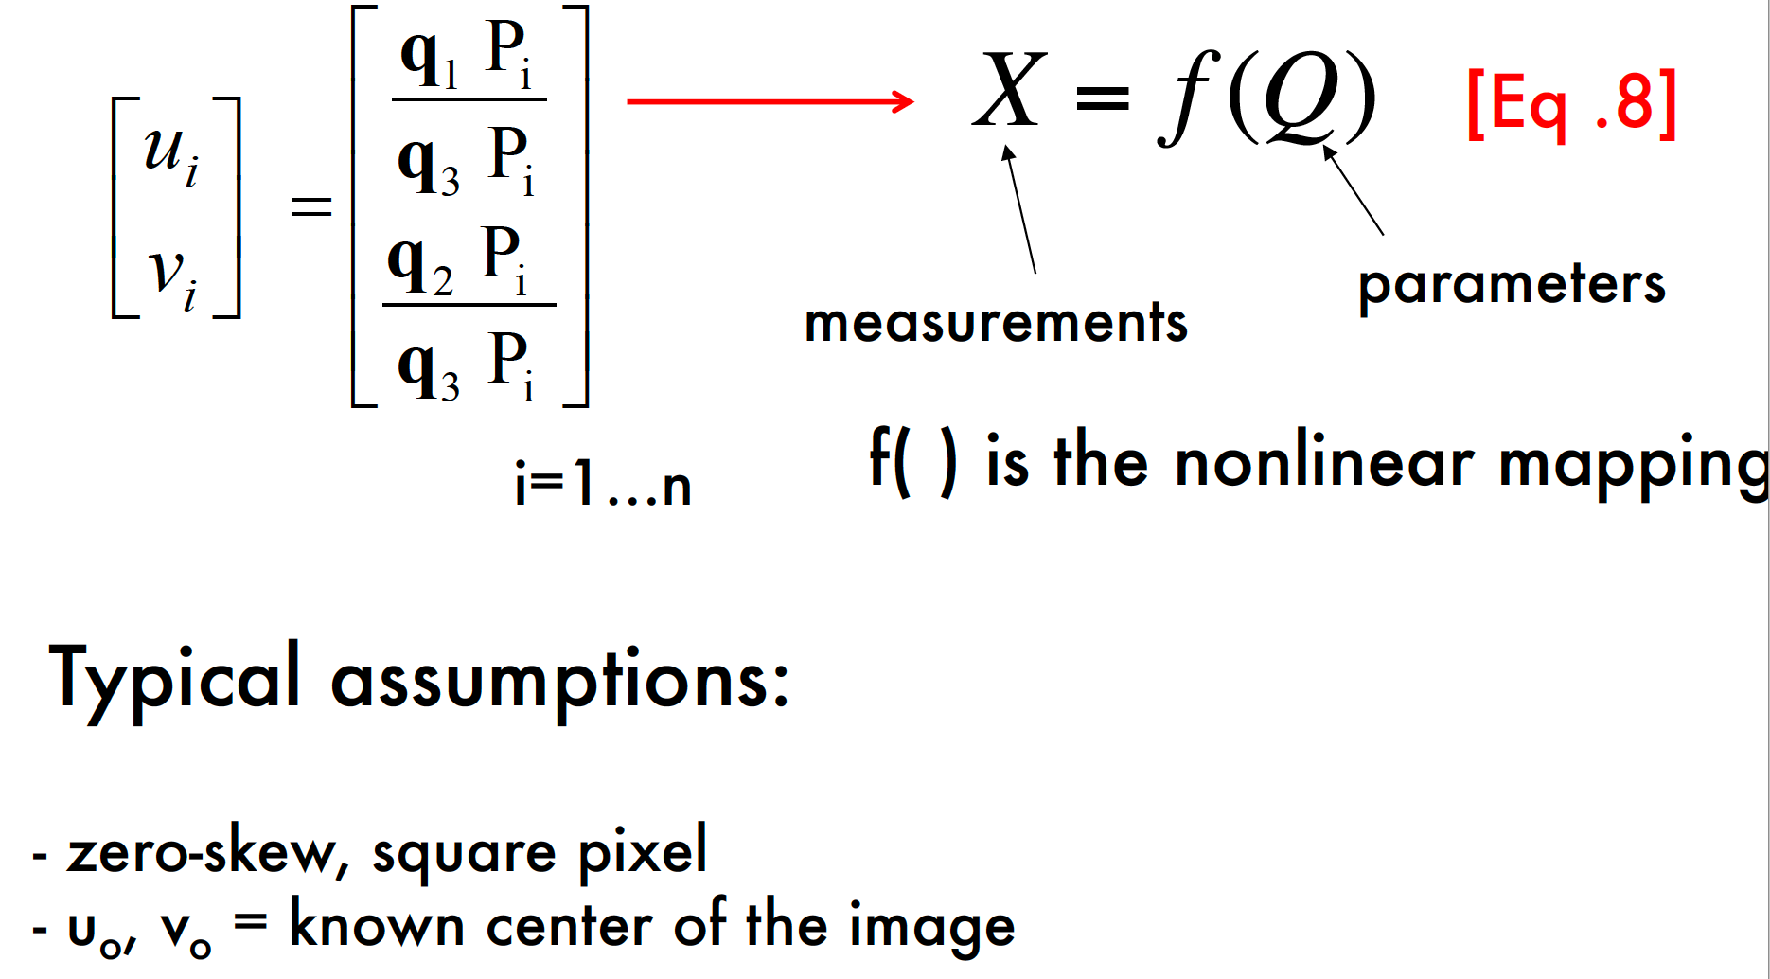
General Calibration Problem

Slide 26
Agenda
Camera calibration problem
Example

Slide 27
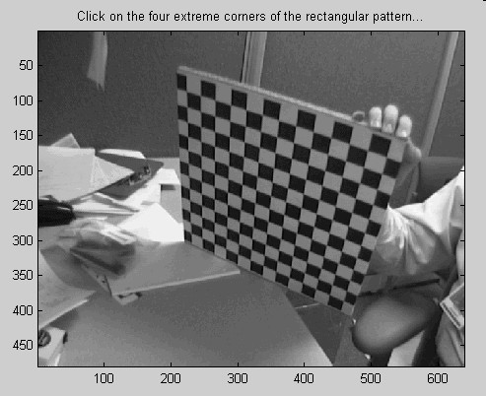
Calibration Procedure
Camera Calibration Toolbox for Matlab J. Bouguet – [1998-2000]
http://www.vision.caltech.edu/bouguetj/calib_doc/index.html#examples

Slide 28
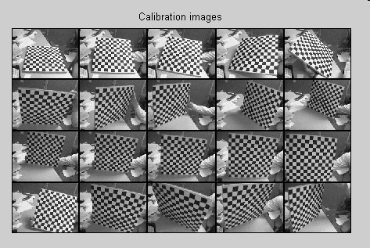
Calibration Procedure

Slide 29
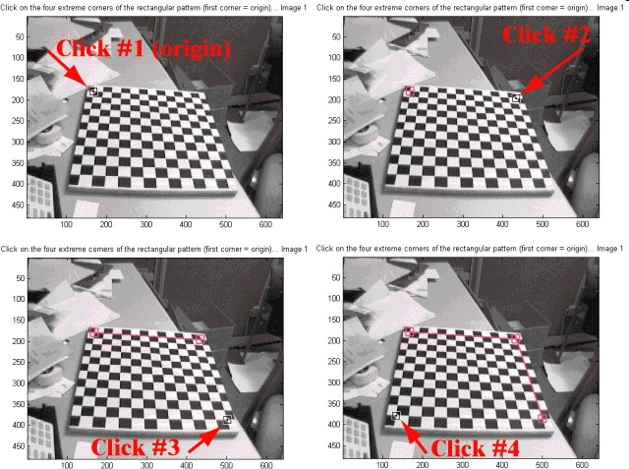
Calibration Procedure

Slide 30
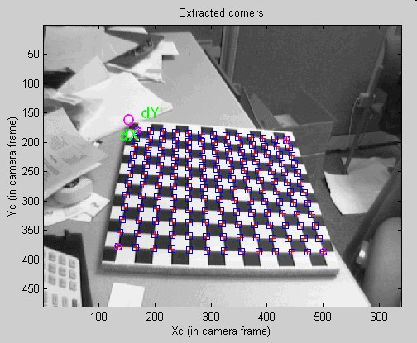
Calibration Procedure

Slide 31
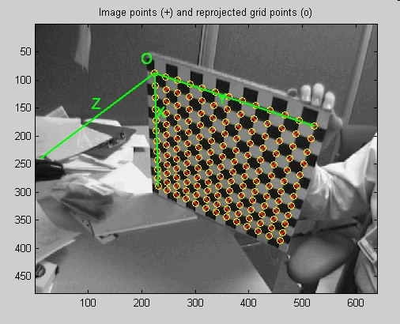
Calibration Procedure

Slide 32
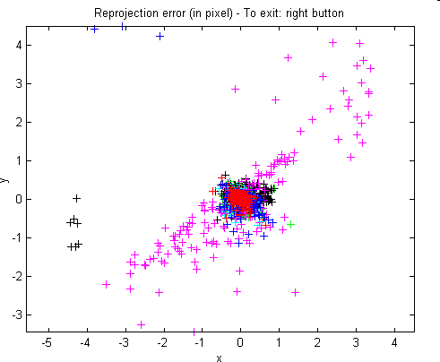
Calibration Procedure

Slide 33
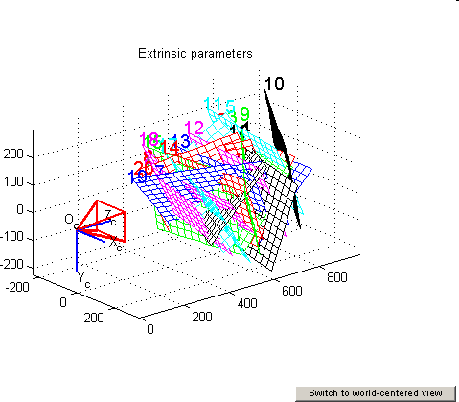
Calibration Procedure

Slide 34
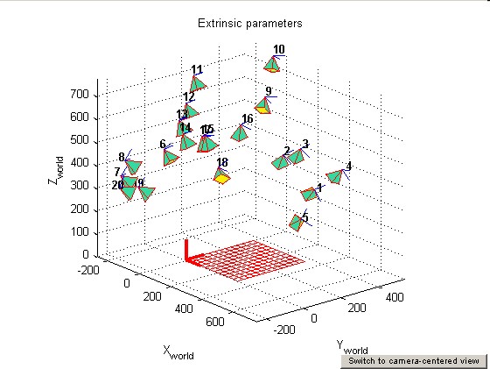
Calibration Procedure

